Slide 1
Fitness buddy agent
IBM AICTE PROJECT
Presented By:
Student name : Kishor Krishna Mugale
College Name & Department : MIT Academy Of Engineering (Computer Engineering)

Slide 2
OUTLINE
Problem Statement
Technology used
Wow factor
End users
Result
Conclusion
Git-hub Link
Future scope
IBM Certifications

Slide 3
Problem Statement
In today’s fast-paced world, many individuals struggle to maintain a healthy lifestyle due to lack of personalized guidance, time constraints, and inconsistent motivation. Traditional fitness solutions often require expensive subscriptions, in-person consultations, or rigid schedules that don't adapt to personal preferences or daily routines. There is a growing need for an accessible, friendly, and intelligent virtual assistant that can provide on-demand fitness advice, healthy lifestyle suggestions, and basic nutrition guidance—all tailored to individual needs and available at any time.
Proposed Solution: Fitness Buddy aims to solve this problem by offering a conversational, AI-powered health and fitness coach that can:
Recommend home workouts and routines based on user input.
Provide motivational tips and daily fitness inspiration.
Suggest simple, nutritious meal ideas.
Encourage habit-building and consistency.

Slide 4
Technology used
IBM cloud lite services
Natural Language Processing (NLP)
IBM Granite model

Slide 5
IBM cloud services used
IBM Cloud Watsonx AI Studio
IBM Cloud Watsonx AI runtime
IBM Cloud Agent Lab
IBM Granite foundation model

Slide 6
Wow factors
This agent will transform personal fitness journeys by offering real-time, adaptive support to users of all fitness levels. It empowers users to stay motivated, track progress, and reach health goals efficiently—whether at home or in the gym—by making fitness guidance more accessible and personalized.
Unique features:
Personalized workout plans for home or gym based on fitness level and goals Nutritional advice tailored for weight loss, muscle gain, or maintenance Progress tracking with data on sets, reps, weight, and calories Daily motivational messages and reminders to stay on track Adaptive routines that evolve weekly based on performance Smart suggestions for recovery, hydration, and sleep optimization Voice-enabled interaction for hands-free workouts and tips

Slide 7
End users
General Public
Gym-goers
Students & Working professionals
Tech-savvy Fitness Users

Slide 8
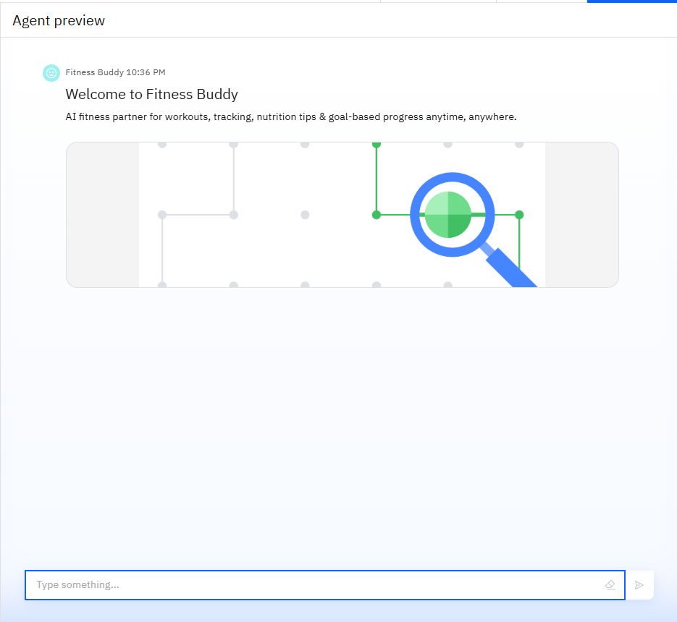
Results

Slide 9
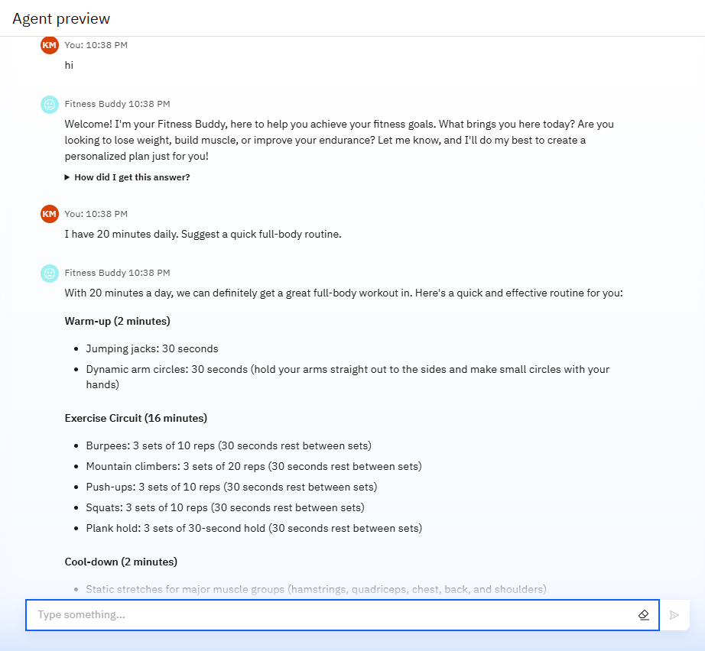
Results

Slide 10
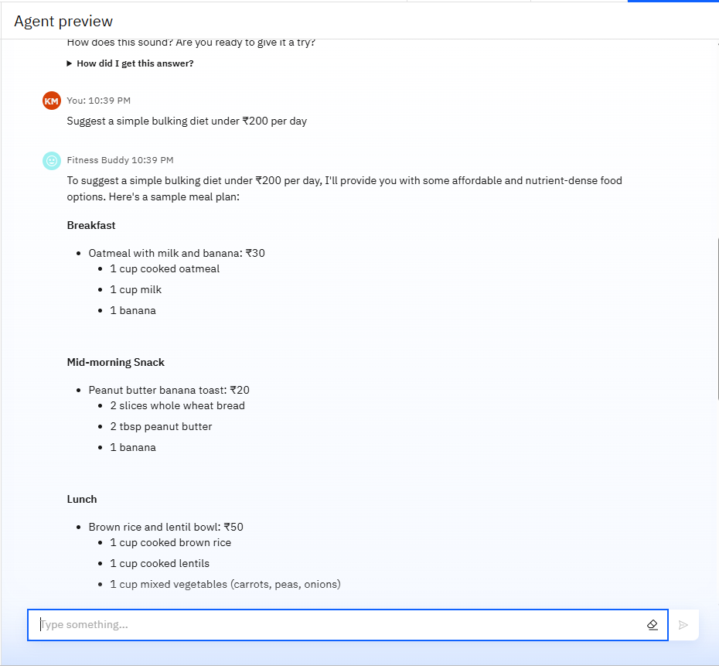
Results

Slide 11
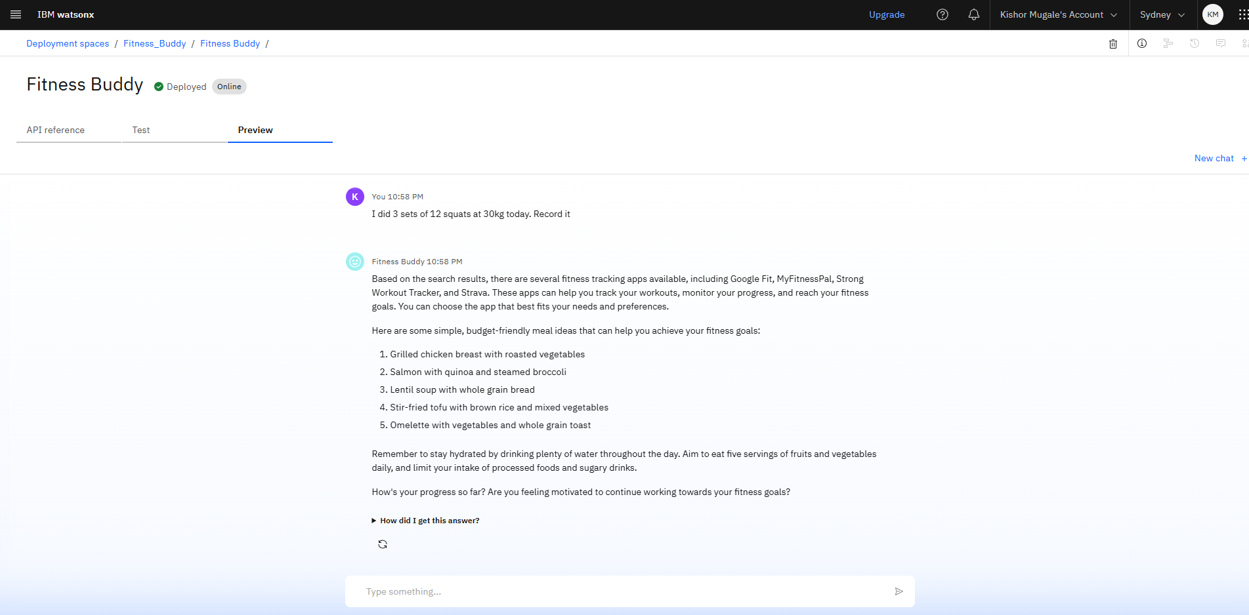
Results
Deployed AI Agent

Slide 12
Conclusion
▪ The agent can create personalized workout and diet plans, offer tips, and adjust based on progress. ▪ It saves time by automating fitness tracking, goal monitoring, and routine optimization. ▪ Fitness Buddy enhances consistency, motivation, and results for users across all fitness levels.

Slide 13
GitHub Link
https://github.com/kishorwtf/Fitness-Buddy

Slide 14
Future scope
▪ Multilingual Fitness Coaching Support ▪ Voice-Activated Workout and Meal Guidance ▪ Real-Time Progress Sharing with Trainers or Friends ▪ AI-Driven Injury Prevention and Posture Correction ▪ Integration with Wearables and Fitness Tracking Devices ▪ Adaptive Training Plans Based on Real-Time Biometrics

Slide 15
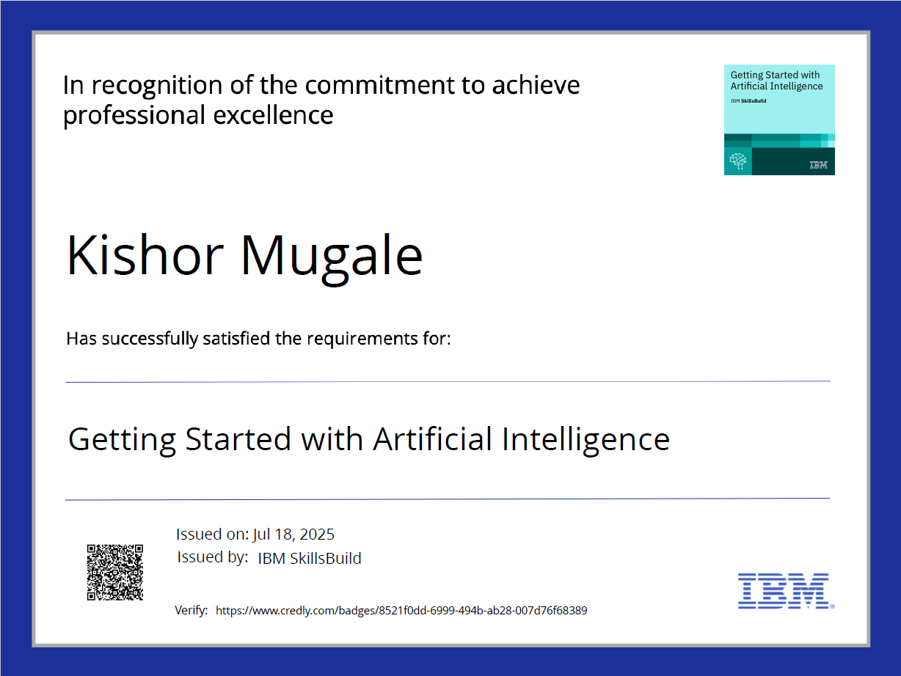
IBM Certifications

Slide 16

IBM Certifications

Slide 17
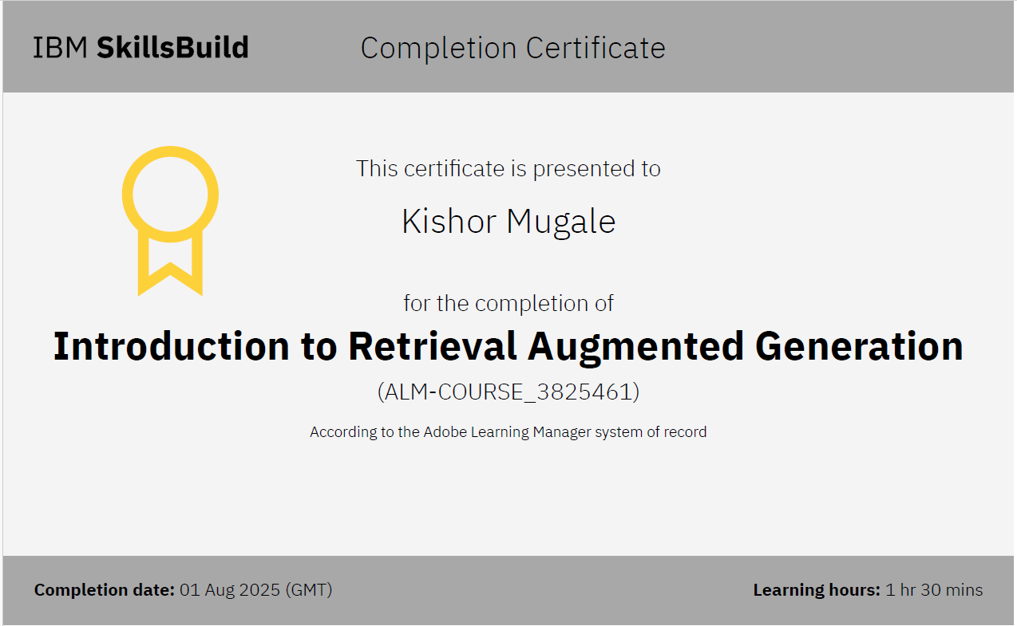
IBM Certifications

Slide 18
THANK YOU

